Slide 1
AI POWERED NUTRITION ANALYSER
Nutrivision
GE19621-Professional Readiness for Innovation, Employability and Entrepreneurship
GOPAL K (210701517)
SIVANANTHAM (210701250)
SANTHOSH M (210701233)

Slide 2
Agenda
Problem Statement
Abstract
Existing System
Proposed System
Technologies Used
Architecture Diagram
Modules
Output
Conclusion
References

Slide 3
Problem statement
In today's fast-paced world, individuals often struggle to maintain a healthy diet and lifestyle due to a lack of accessible, reliable, and personalized nutritional information.
Many people are unaware of the nutritional content of the foods they consume, find it challenging to create and follow balanced diet plans, and lack tools to accurately track their caloric expenditure from workouts.
This gap in knowledge and resources can lead to poor dietary choices, resulting in various health issues such as obesity, malnutrition, and lifestyle-related diseases.
There is a critical need for an integrated solution that provides users with the necessary tools to understand their nutritional intake, plan their diets, and monitor their physical activity to support better health outcomes.

Slide 4
Abstract
The Nutrition Analyser app is a multifaceted tool designed to empower users with the ability to manage and optimize their dietary and nutritional habits.
This application provides a user-friendly interface for accessing detailed nutritional information for a wide variety of foods, facilitating informed dietary choices.
To continue with, it enables users to create and customize their own diet plans, tailored to their individual health goals and preferences.
In addition to that , NutriVision also provides the feature of Calorie Burnt Prediction and providing user information about standardised diet plans.

Slide 5
EXISTING SYSTEM
Users must gather health and fitness information from multiple sources, often resulting in contradictory advice and confusion due to fragmented content.
Existing platforms often provide generic advice that fails to cater to individual dietary and fitness needs, leading to ineffective results.
Many users rely on manual tracking methods for nutrition and exercise, which are time-consuming and prone to errors, limiting accuracy.
Current health and fitness apps may lack integration with the latest technology, reducing their effectiveness and user engagement with outdated interfaces.

Slide 6
PROPOSED SYSTEM
Provides a single platform which features a Nutritional Value Finder that allows users to input food names and retrieve detailed nutritional information, including calories, fats, proteins, and other nutrients.
The Custom Diet Plan Creator enables users to design and manage personalized diet plans, offering the flexibility to add, update, and delete meal plans for each day of the week.
Additionally, the Calorie Burn Calculator helps users estimate the calories burned during workouts by inputting workout specifics.
Enhances user engagement and efficiency in fitness regulation through a user-friendly interface, providing a comprehensive tool for maintaining a healthy lifestyle."

Slide 7
TECH STACK
HTML & CSS
JavaScript
React.js
Node.js
Express.js
Python
MongoDB

Slide 8
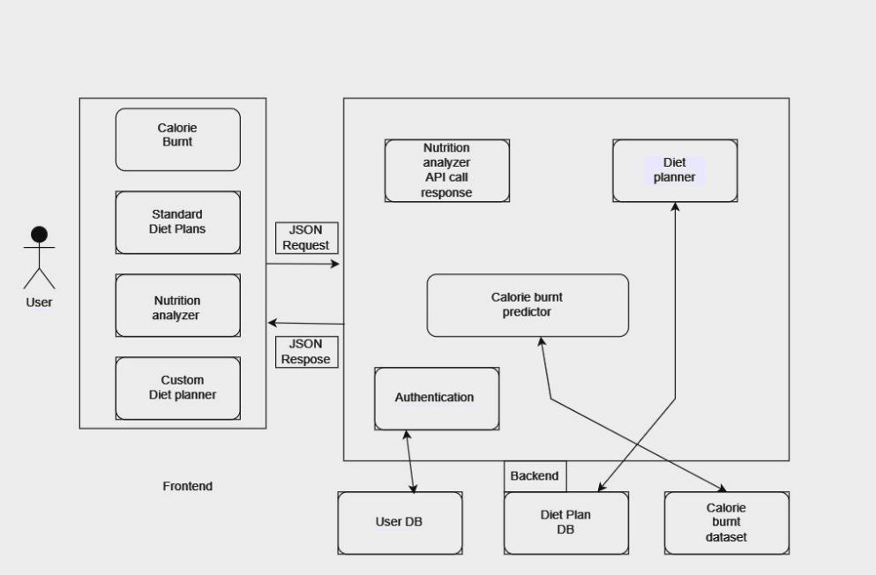
SYSTEM ARCHITECTURE
Fig. NutriVision System Architecture

Slide 9
MODULES
Sing Up Module
Sign In Module
Forgot Password
Nutrition Analysis
Calorie Tracker
Diets
Diet Planner

Slide 10
MODULES
1 Sign up Module
The SignUp module enables users to create accounts by providing essential details such as username, email, and password. It ensures data security through password encryption techniques and includes verification steps like email confirmation for account validity.
2 Sign In module
The login module facilitates user authentication, allowing registered users to access their accounts securely. It verifies user credentials, such as username/email and password, against stored data in the system's database

Slide 11
MODULES
3 Forgot password module
Enter the email address associated with your account. Check your inbox for an email from us with instructions on how to reset your password. If you don't see it, be sure to check your spam or junk folder. Click on the password reset link provided in the email.
Nutrition Analyser module
The Nutrition Analyzer module processes user-input, food data to generate detailed nutritional values, including carbohydrates, protein, fat, and glucose levels.

Slide 12
modules
5 Standard Diet Module
The Standard Diet Plans module presents users with a curated selection of established diet plans tailored for various health objectives, including weight gain, weight loss, and balanced nutrition
6 Diet Planner module
The Custom Diet Planner module empowers users to create personalized meal plans tailored to their preferences and dietary goals. Users can input their meal and snack preferences for each day of the week.

Slide 13
MODULEs
7 Calorie Burnt Predictor Module
The Calorie Burn Predictor module employs the XGBoost Regressor (XGBRegressor) algorithm to estimate calorie expenditure during exercise.
Inputs Required for the Model:
Age
Gender
Height
Weight
Heart Rate
Body Temperature
Duration of workout

Slide 14
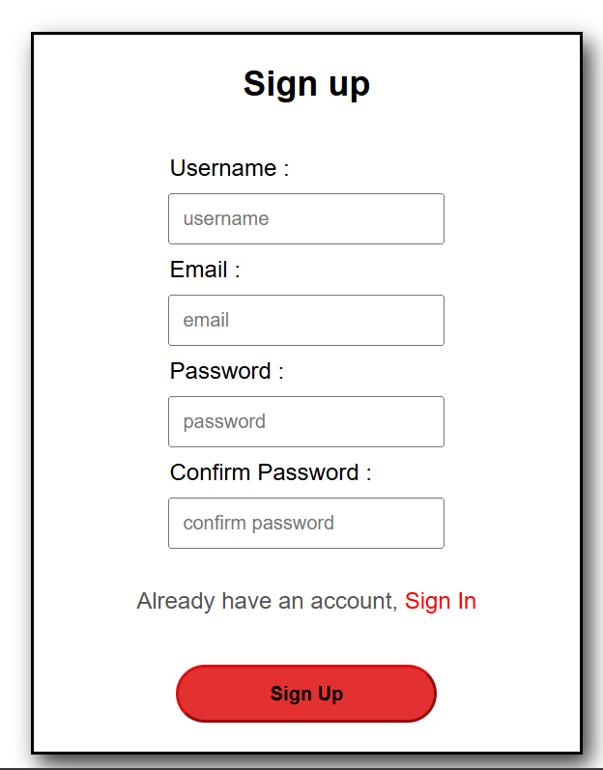
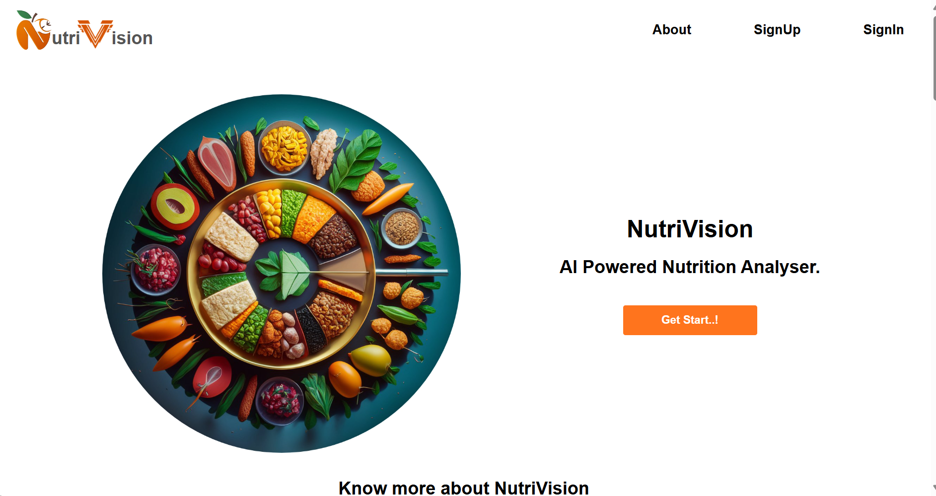
output
Landing Page
Sign Up page

Slide 15
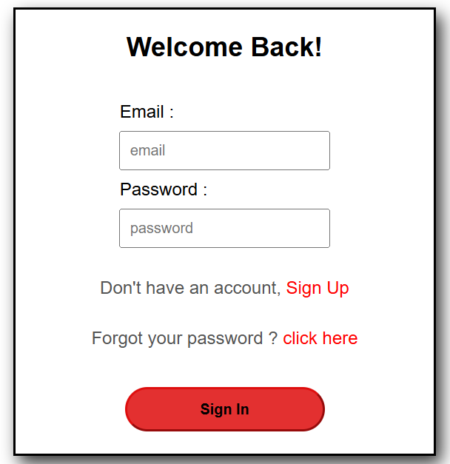
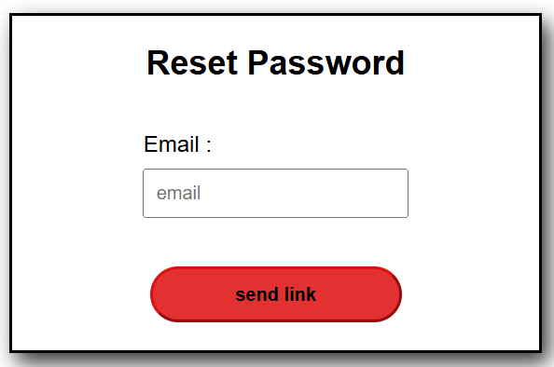
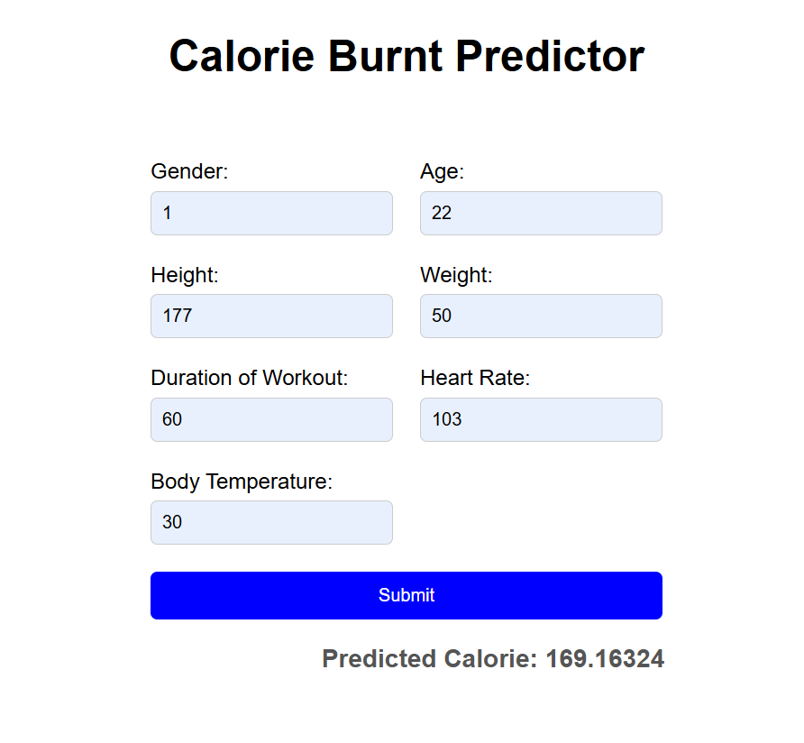
output
Forgot Password Page
Sign-In Page
Calorie Burnt Predictor

Slide 16
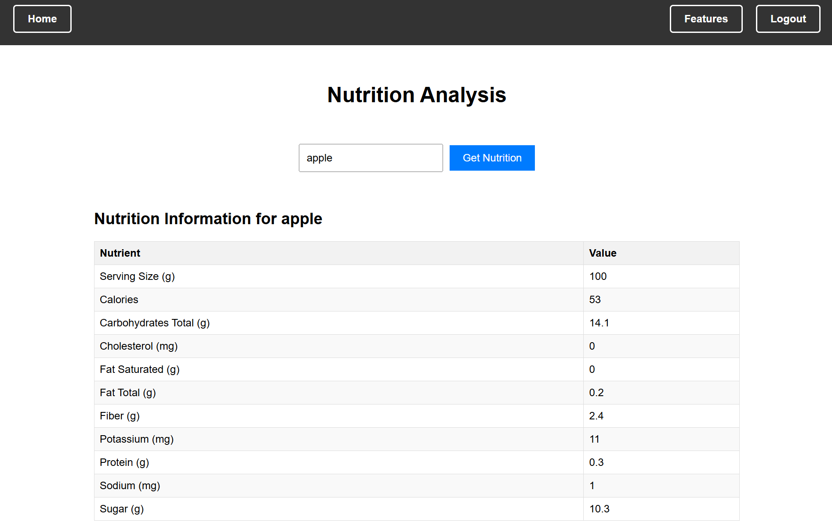
OUTput
Nutritional Analysis Page

Slide 17
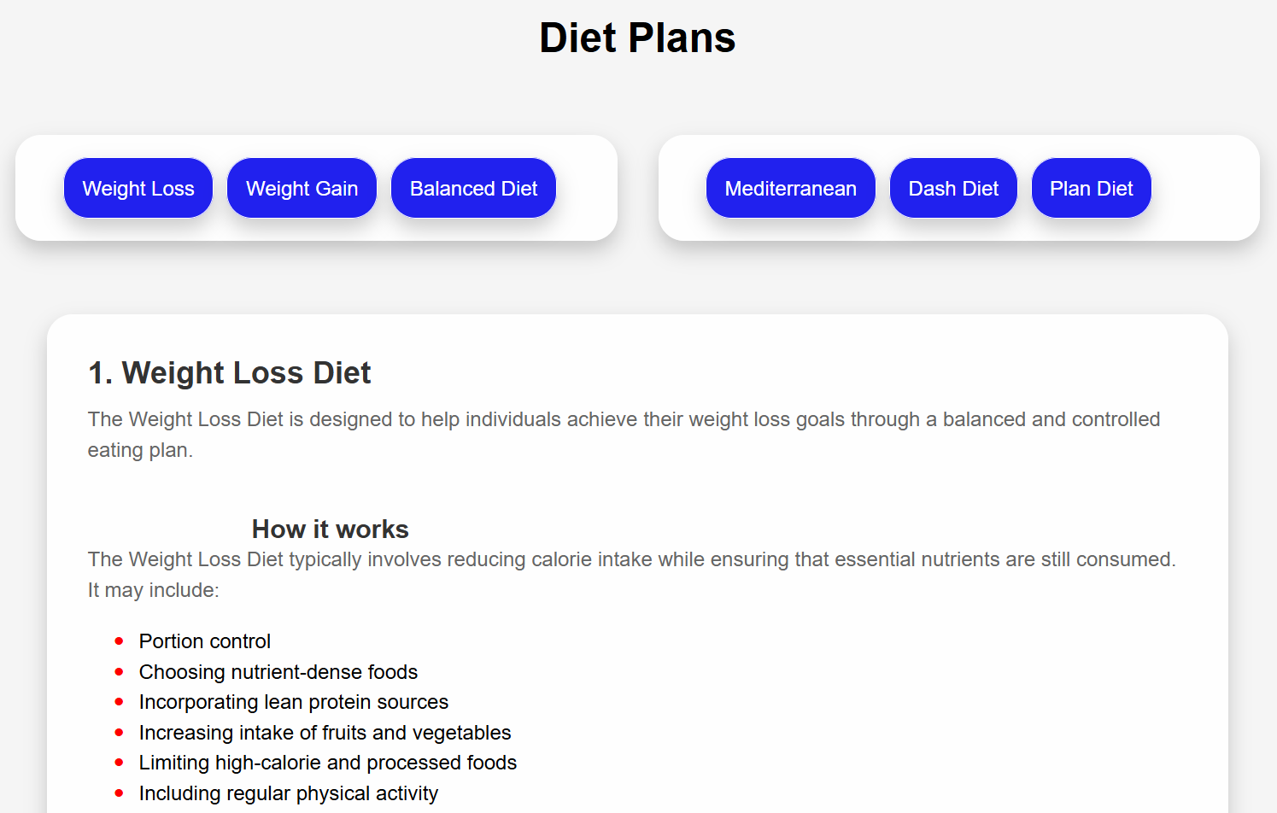
output
Standard Diet Plans

Slide 18
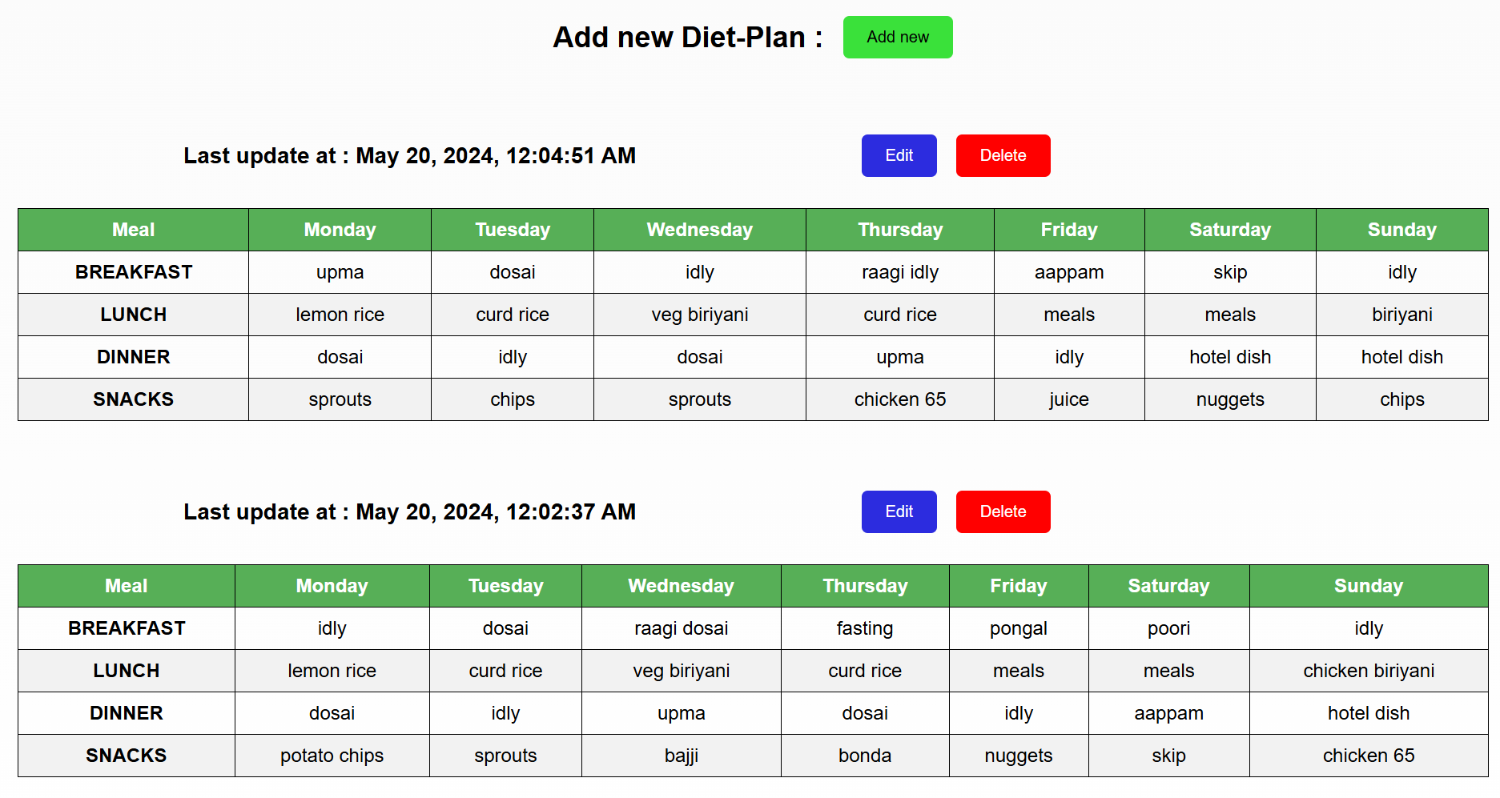
output
Diet Planner

Slide 19
Conclusion & future enhancement
In conclusion, our AI-powered nutrition analyzer is leading the way in improving food monitoring for people who are passionate about their health and fitness. Our platform goes beyond conventional approaches by combining modern artificial intelligence (AI) with customized insights to provide personalized nutrition recommendations based on goals and needs.
FUTURE ENHANCEMENT
Chat Bot
Nutrition chatbots are guided software programs designed to simulate human conversations.
When equipped with AI, these chatbots can understand complex queries and provide bespoke responses.
They interact with users just like a dietician or nutrition expert would.
Conversational AI technology enables them to understand human language and interpret text effectively.

Slide 20
REFERENCES
S. Banerjee and A. C. Mondal, "Nutrient Food Prediction Through Deep Learning," 2021 Asian Conference on Innovation in Technology (ASIANCON), PUNE, India, 2021, pp. 1-5, doi: 10.1109/ASIANCON51346.2021.9545014.
S. -C. Huang, W. -C. Chiang, Y. -T. Yang and J. -S. Wang, "An Image-based AI Nutrition Analysis Platform for Food in Compartment Trays," 2023 14th IIAI International Congress on Advanced Applied Informatics (IIAIAAI), Koriyama, Japan, 2023, pp. 373-374, doi: 10.1109/IIAIAAI59060.2023.00079.
] E. Dashkova and R. Dorokhova, "SmartDiet — Personal wellbeing assistant and diet planner mobile service," 2012 11th Conference of Open Innovations Association (FRUCT), St. Petersburg, Russia, 2012, pp. 35-39, doi: 10.23919/FRUCT.2012.8253106.

Slide 21
REFERENCES
P. Slade, "DIY Activity Tracker: Count Your Calories More Accurately than a Smartphone," in IEEE Spectrum, vol. 58, no. 10, pp. 14-16, October 2021, doi: 10.1109/MSPEC.2021.9563960.
] L. Guo, J. Zhang, J. Yu, G. Wang, Y. Qi and T. Liu, "Diet Planning Models Based on Linear Programming Theory for Catering Problems," 2023 2nd International Conference on Automation, Robotics and Computer vi Engineering (ICARCE), Wuhan, China, 2023, pp. 1-4, doi: 10.1109/ICARCE59252.2024.10492475.

Slide 22
Stay Fit & Healthy
Thank You

